Slide 1
Contractor Management Guide
Contractor Admin Guide
KPA Flex

Slide 2
Logging In

Slide 3
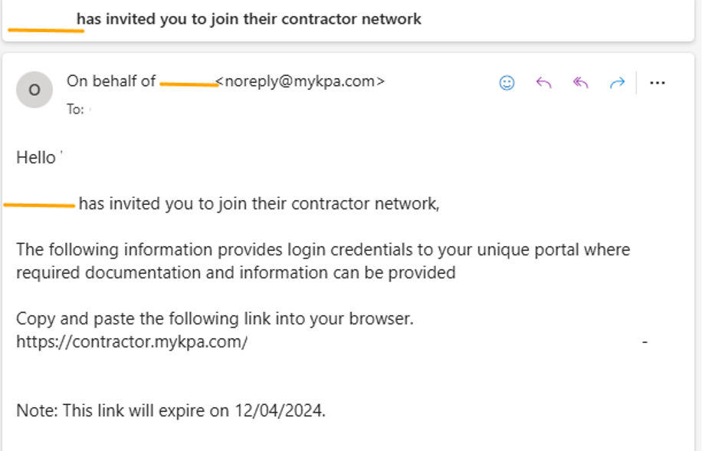
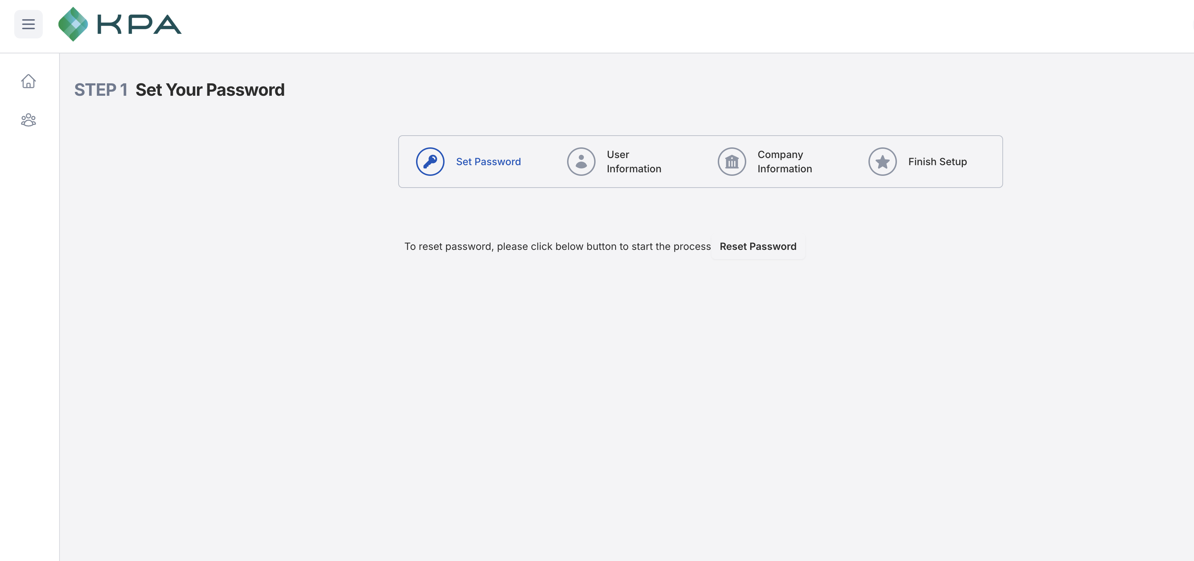
Contractor Login
The Admin will receive a welcome email on behalf of your company’s KPA flex site. And then they need to follow the instructions on logging in.
Step 1:
The contractor needs to copy and paste the link in a browser to login into the Contractor Management portal.
They can use the link in this email to change their company information as well.
The link will expire in a month.
Step 2:
Setup your password by clicking the reset password link.

Slide 4
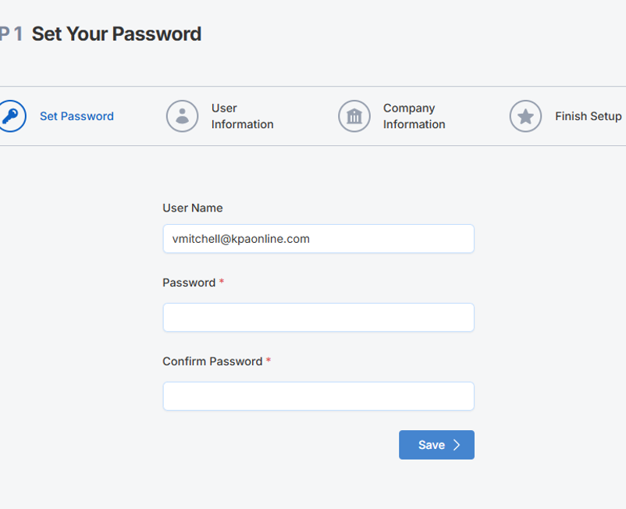
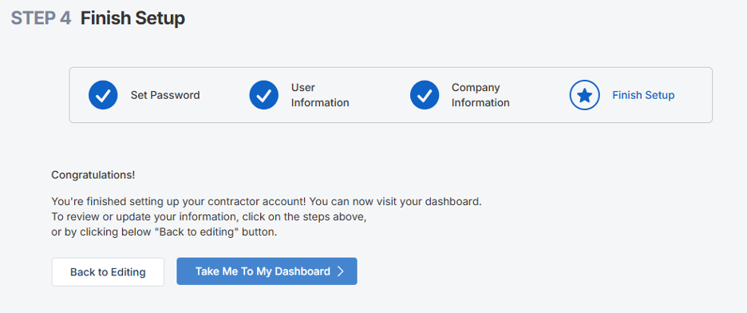
Contractor Login Continued…
Continue to follow the instructions on logging in.
Step 3:
Create a new password and confirm the new password by entering it again.
Click the blue save button.
Step 4:
You have finish creating your account.
You can go back to editing your company information or go to your contractor dashboard to see your contractor requirements.

Slide 5
Completing Requirements

Slide 6
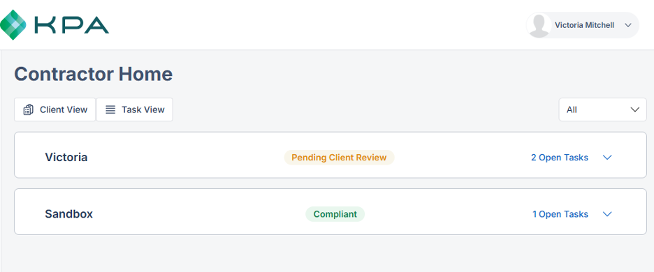
Contractor Dashboard
Click on a Client to open the tasks/requirements to complete
The Contractor has two views: Client View and Task View.
The client view is default to show the different clients the contractor works with.
The task view will show all requirements the contractor has to complete regardless on the client who assigned it.
Click on any task to start completing it.
Once you complete a task, your task is pending the Client Admin review.

Slide 7
Managing Users

Slide 8
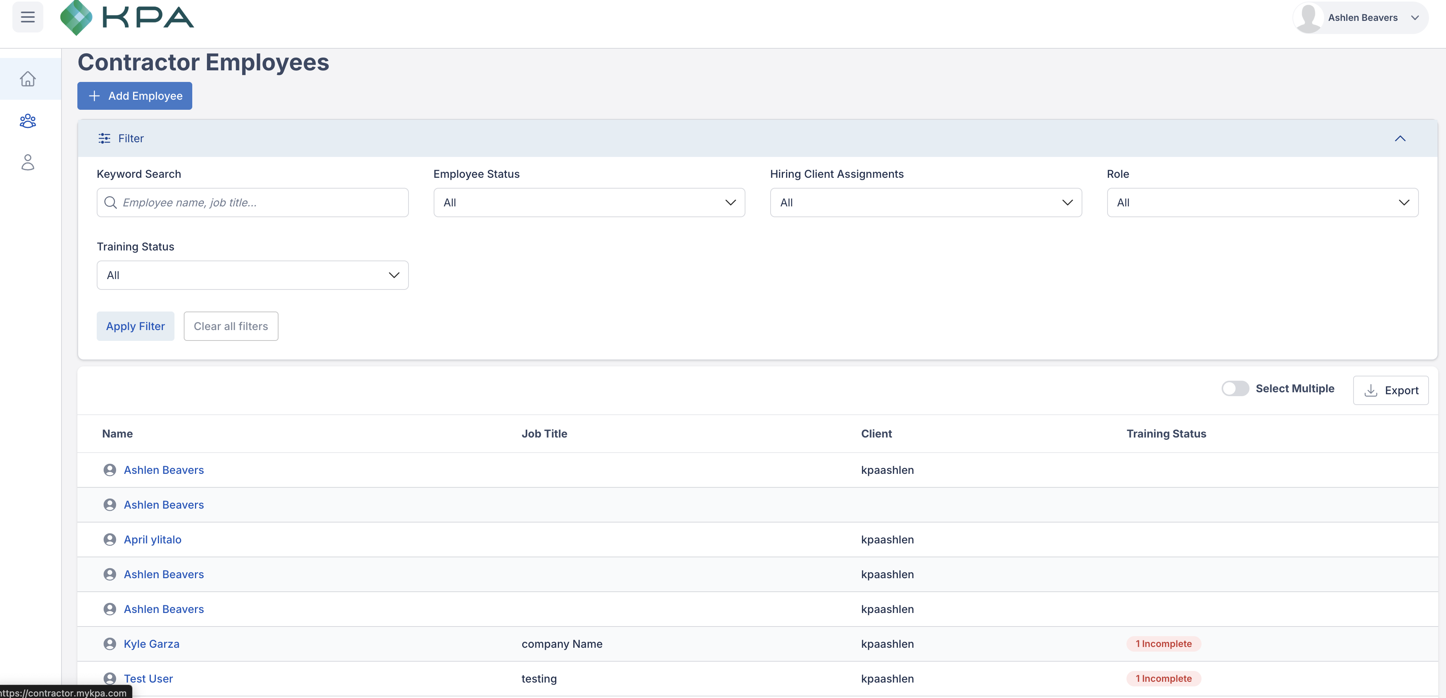
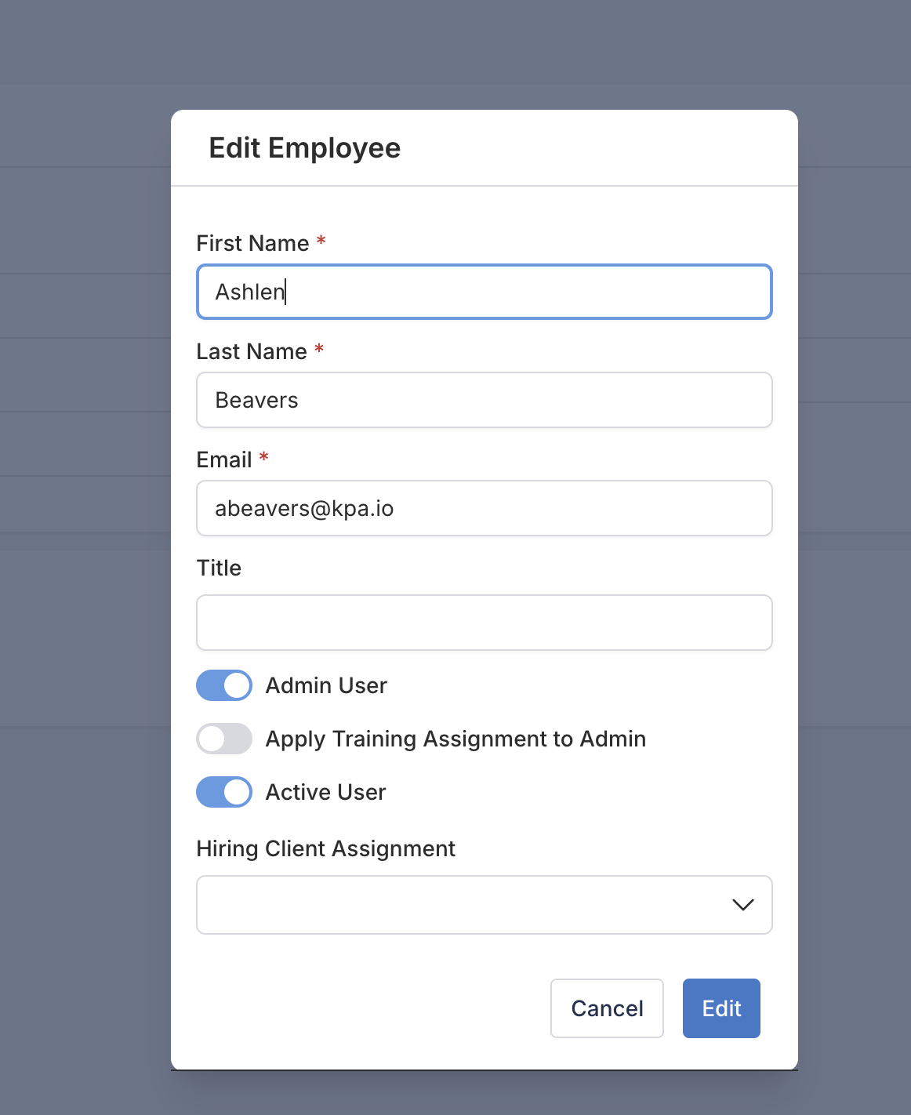
Adding and editing Employees
Admins can click on Employees to add new employees or click on an employee name to edit existing employee profiles.

Slide 9
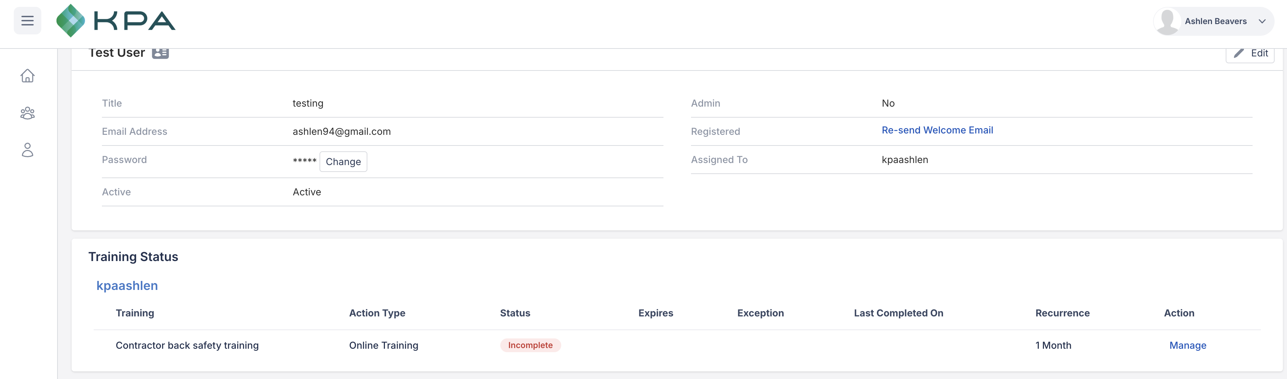
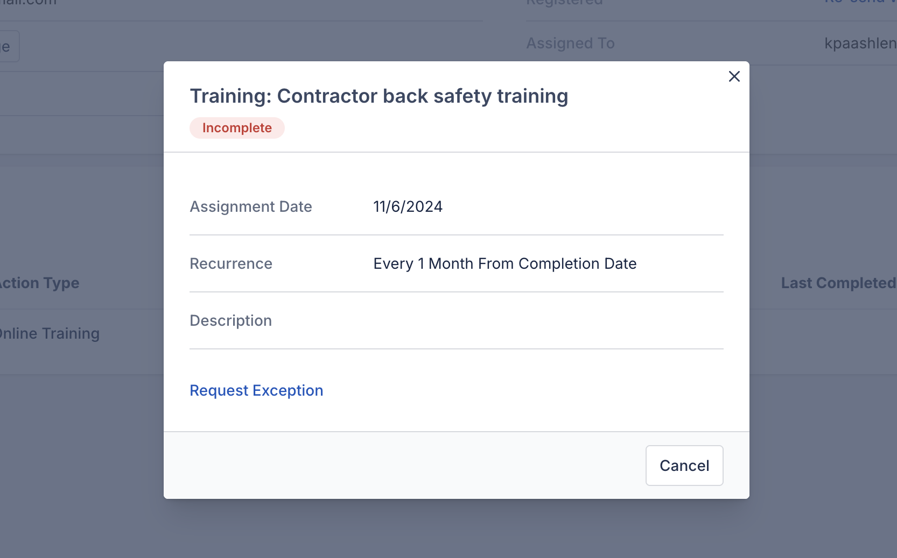
Edit Employee Profile
When editing an employee profile, the contractor admin can change the user’s password, resend the welcome email or manage the training requirements.
The contractor admin can request a training exception. They will wait for the Client Admin to approve the request.

Slide 10
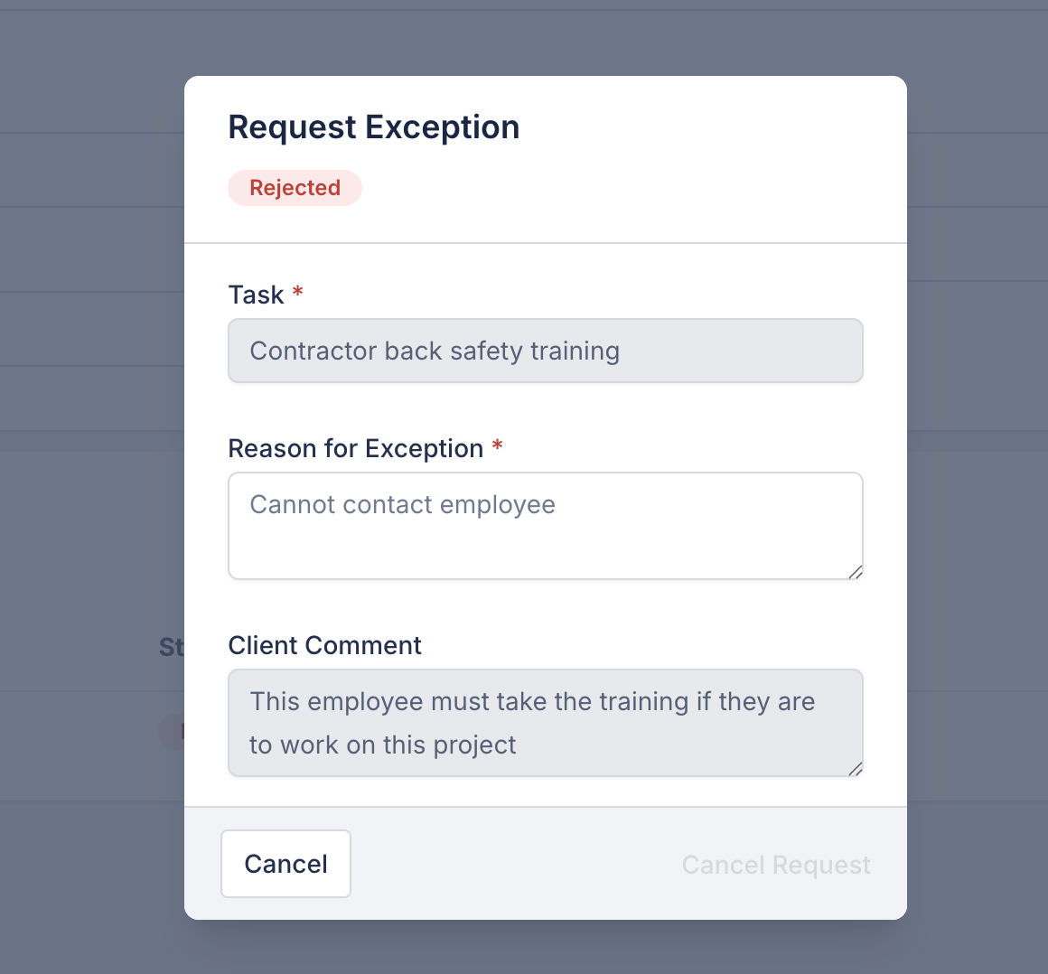
Training Exception Status
The Contractor Admin can click on the exception status to see any comments the client admin wrote with the status (approval or rejection).
If the exception is rejected, then the employee must complete the training.

